Slide 1

World Wide Energy Consumption

Slide 2
Name : Sana Ahmed
Qualification : BCA
From : Raipur , CG
Linked in : www.linkedin.com/in/sana-ahmed-25nov
Github : https://github.com/SanaAhmed25

Slide 3
AGENDA
Objective of the Project
ER Diagram and schema explanation
Key analysis questions (use cases)
SQL query results with screenshots or summaries
Final business insights and recommendations
Conclusion (Key finding overall)
Q&A Slide
My Experience/Challenges working on SQL – Data Analysis Project.

Slide 4
Objective of the Project
The project aims to transform raw datasets into meaningful insights that support discussions on energy sustainability, economic growth, and climate change at the global level.
The main objective of this project is to analyze global energy consumption, production, emissions, population, and GDP data using SQL in order to:
Understand trends over time (2020–2023) across major countries.
Compare energy consumption and production patterns at country and global levels.
Evaluate per-capita energy usage and emissions to assess sustainability.
Identify countries with rising or declining emissions and highlight their progress in adopting cleaner energy.
Provide data-driven insights into the relationship between economic growth (GDP) and environmental impact (emissions and energy use).

Slide 5
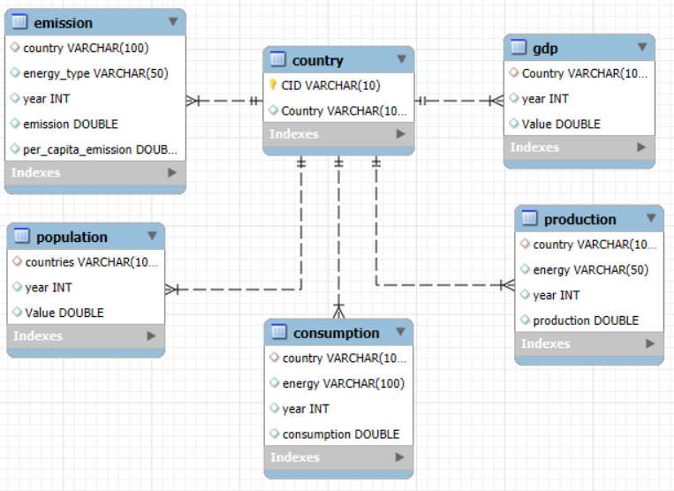
ER Diagram

Slide 6
Schema explanation

Slide 7
Database Schema Explanation – EnergyConsump
1. country
Columns:
CID → Country ID (Primary Key).
Country → Country name (Unique).
Notes: All other tables reference Country to maintain referential integrity.
2. emission
Columns:
country → References country.Country.
energy_type → Energy source (e.g., Coal, Oil, Gas, Renewables).
year → Reporting year.
emission → Total emissions (numeric).
per_capita_emission → Emission per person (emission ÷ population).
3. population
Columns:
countries → References country.Country.
year → Reporting year.
Value → Population count.
4. production
Columns:
country → References country.Country.
energy → Energy type (e.g., Oil, Gas, Renewables).
year → Reporting year.
production → Energy produced (numeric).

Slide 8
5. gdp
Columns:
Country → References country.Country.
year → Reporting year.
Value → GDP value (numeric, usually in USD).
6. consumption
Columns:
country → References country.Country.
energy → Type of energy consumed.
year → Reporting year.
consumption → Energy consumed (numeric).
Relationships & Data Flow
Central Table: country → all other tables reference this for consistency.
One-to-Many Relationships:
Country → Population (one country, many years).
Country → GDP (one country, many years).
Country → Production & Consumption (one country, many years × energy types).
Country → Emission (one country, many years × energy types).

Slide 9
Key Analysis Questions

Slide 10
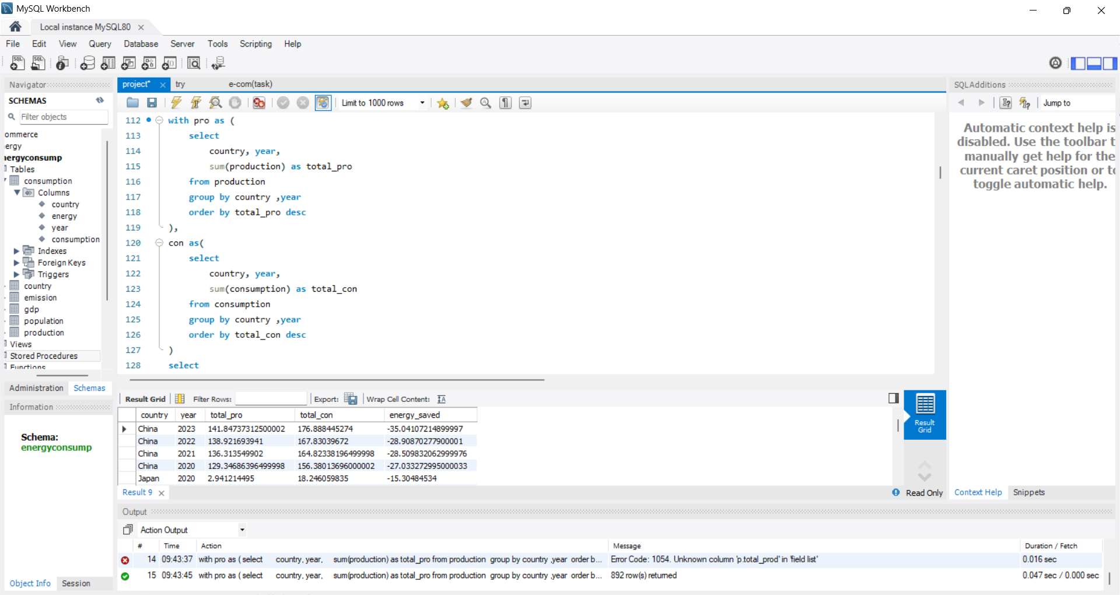
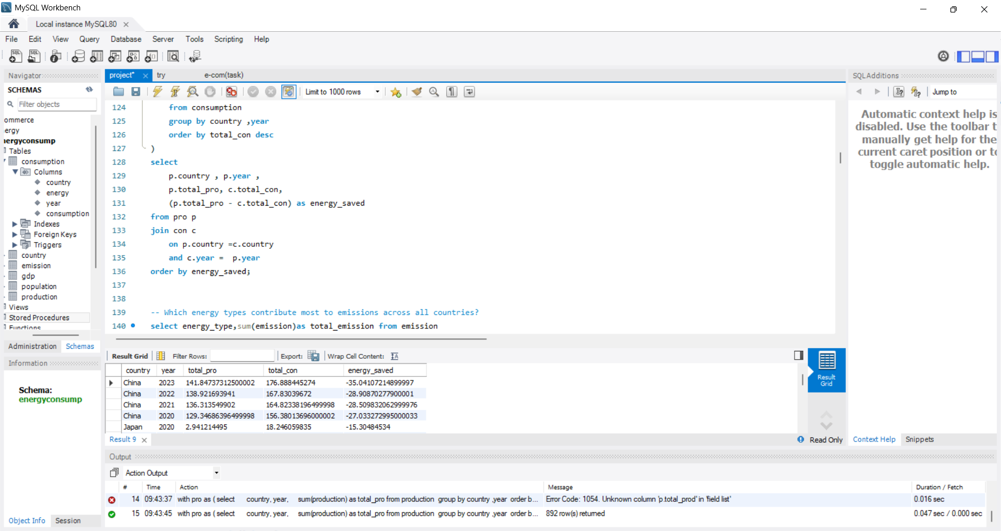
1. Compare energy production and consumption by country and year.
Query :

Slide 11
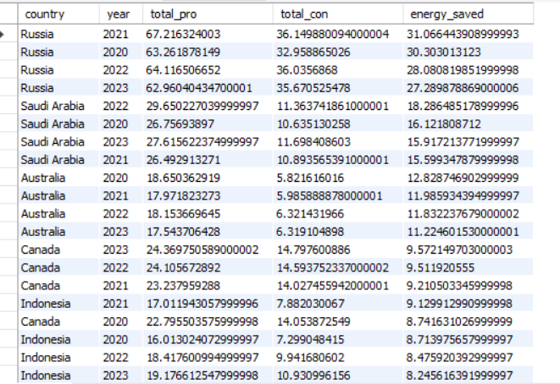
1. Compare energy production and consumption by country and year.
Output :
Insight:
Many countries have higher energy production than their consumption, which results in an energy surplus.
These nations not only meet their domestic needs but also save energy and, in many cases, export the excess to other countries.
Examples include energy-rich nations with abundant natural resources (like Coal, gas, Petroleum).

Slide 12
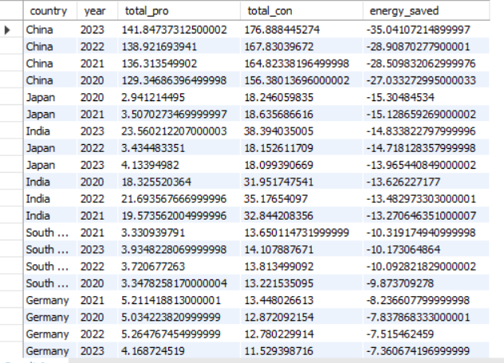
1. Compare energy production and consumption by country and year.
Output :
Insight:
On the other hand, countries like China, Japan and India show the opposite trend:
Their energy consumption is significantly higher than their domestic production.
This imbalance creates an energy deficit, forcing them to rely heavily on imports to meet the growing demand driven by population growth, industrialization, and economic expansion.

Slide 13
1. Compare energy production and consumption by country and year.
Conclusion
Countries with surplus energy contribute to global energy stability and trade.
Countries with deficits face challenges of import dependence, higher costs, and energy security risks.

Slide 14
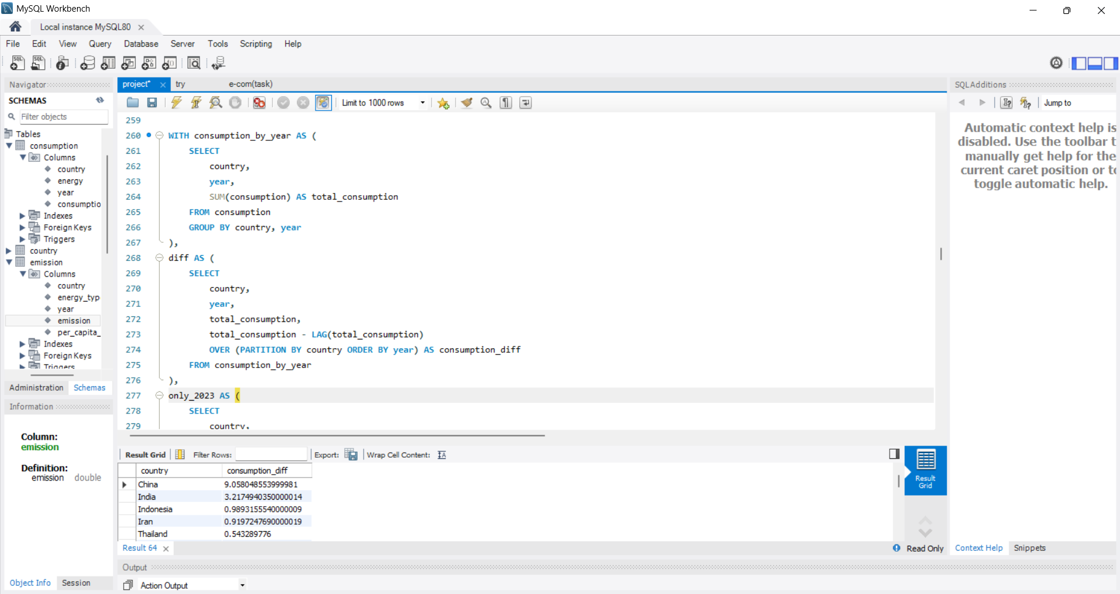
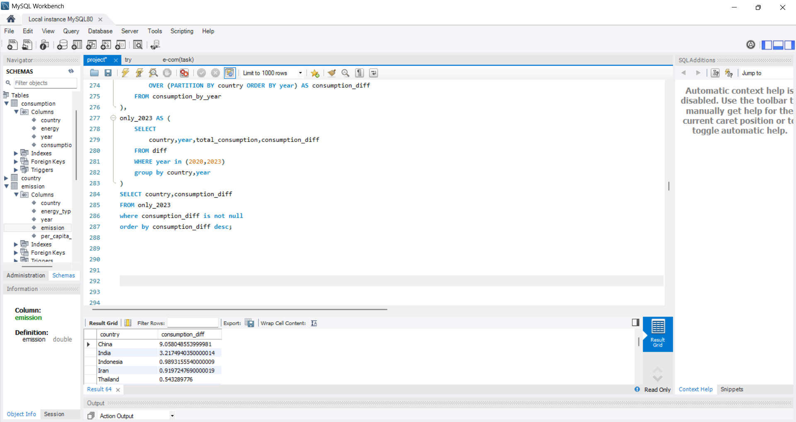
2. Has energy consumption increased or decreased over the years for major economies?
Query :

Slide 15
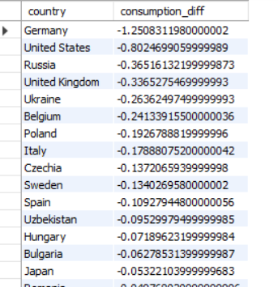
2. Has energy consumption increased or decreased over the years for major economies?
Output :
Insight:
Between 2020–2023, advanced economies such as Germany, Russia, and the U.S. saw declining energy consumption driven by efficiency gains, renewables, and lower industrial output

Slide 16
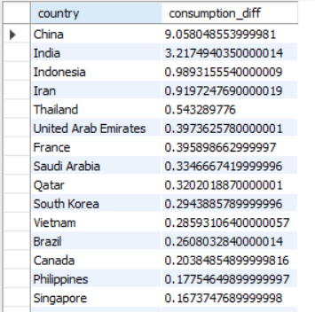
2. Has energy consumption increased or decreased over the years for major economies?
Output :
Insight:
Emerging economies like China and India experienced strong growth in energy use fueled by rapid economic expansion and rising electricity demand.

Slide 17
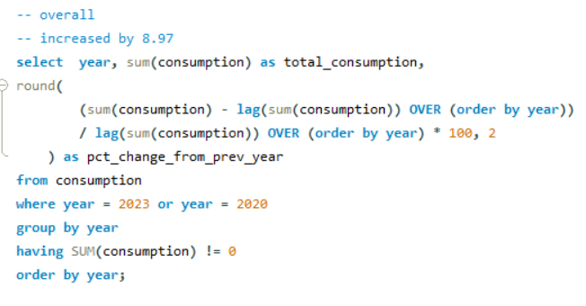
2. Has energy consumption increased or decreased over the years for major economies?
Query :

Slide 18
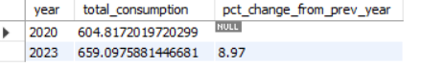
2. Has energy consumption increased or decreased over the years for major economies?
Output :
Conclusion
From 2020 to 2023, global energy consumption increased by 8.97%.
The increase mainly comes from large and fast-growing economies like India and China

Slide 19
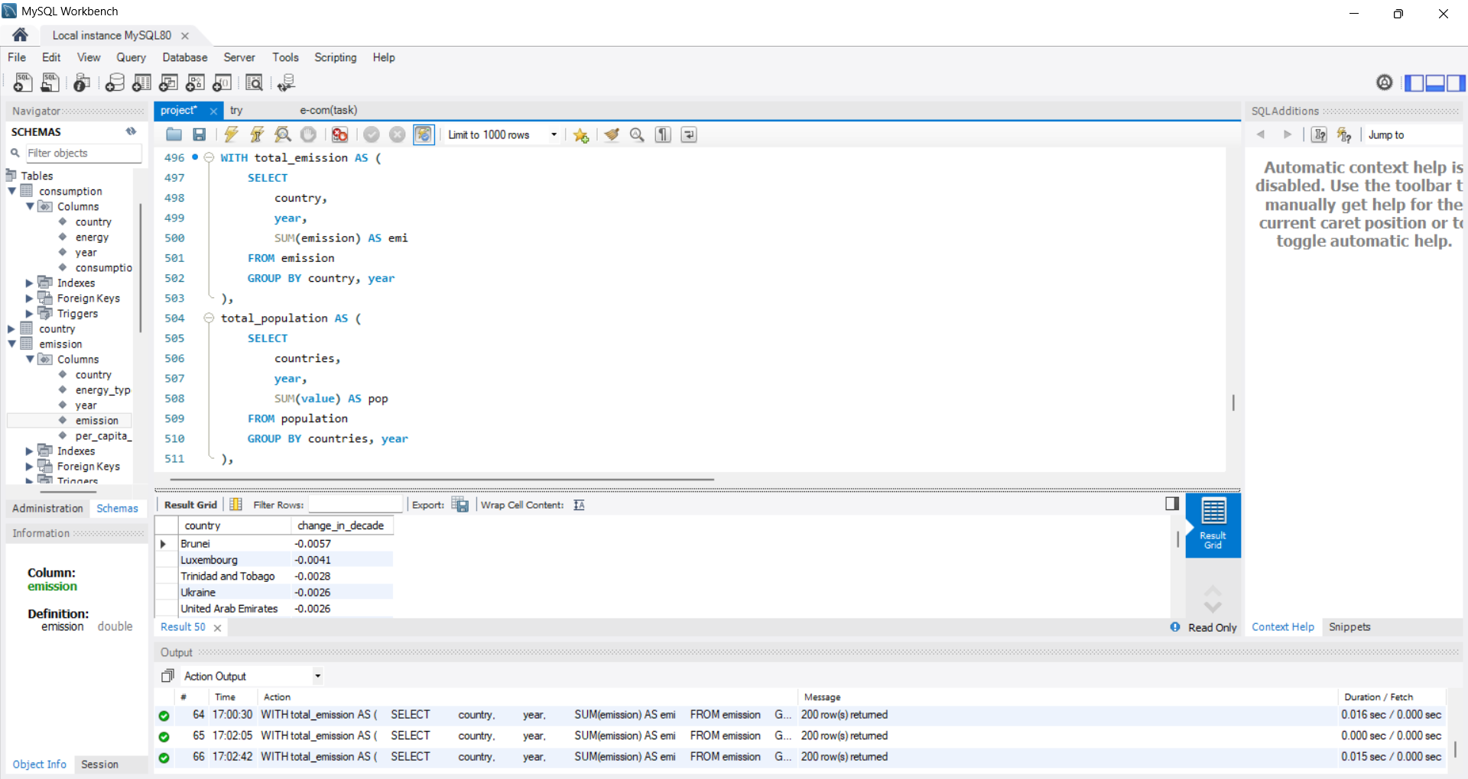
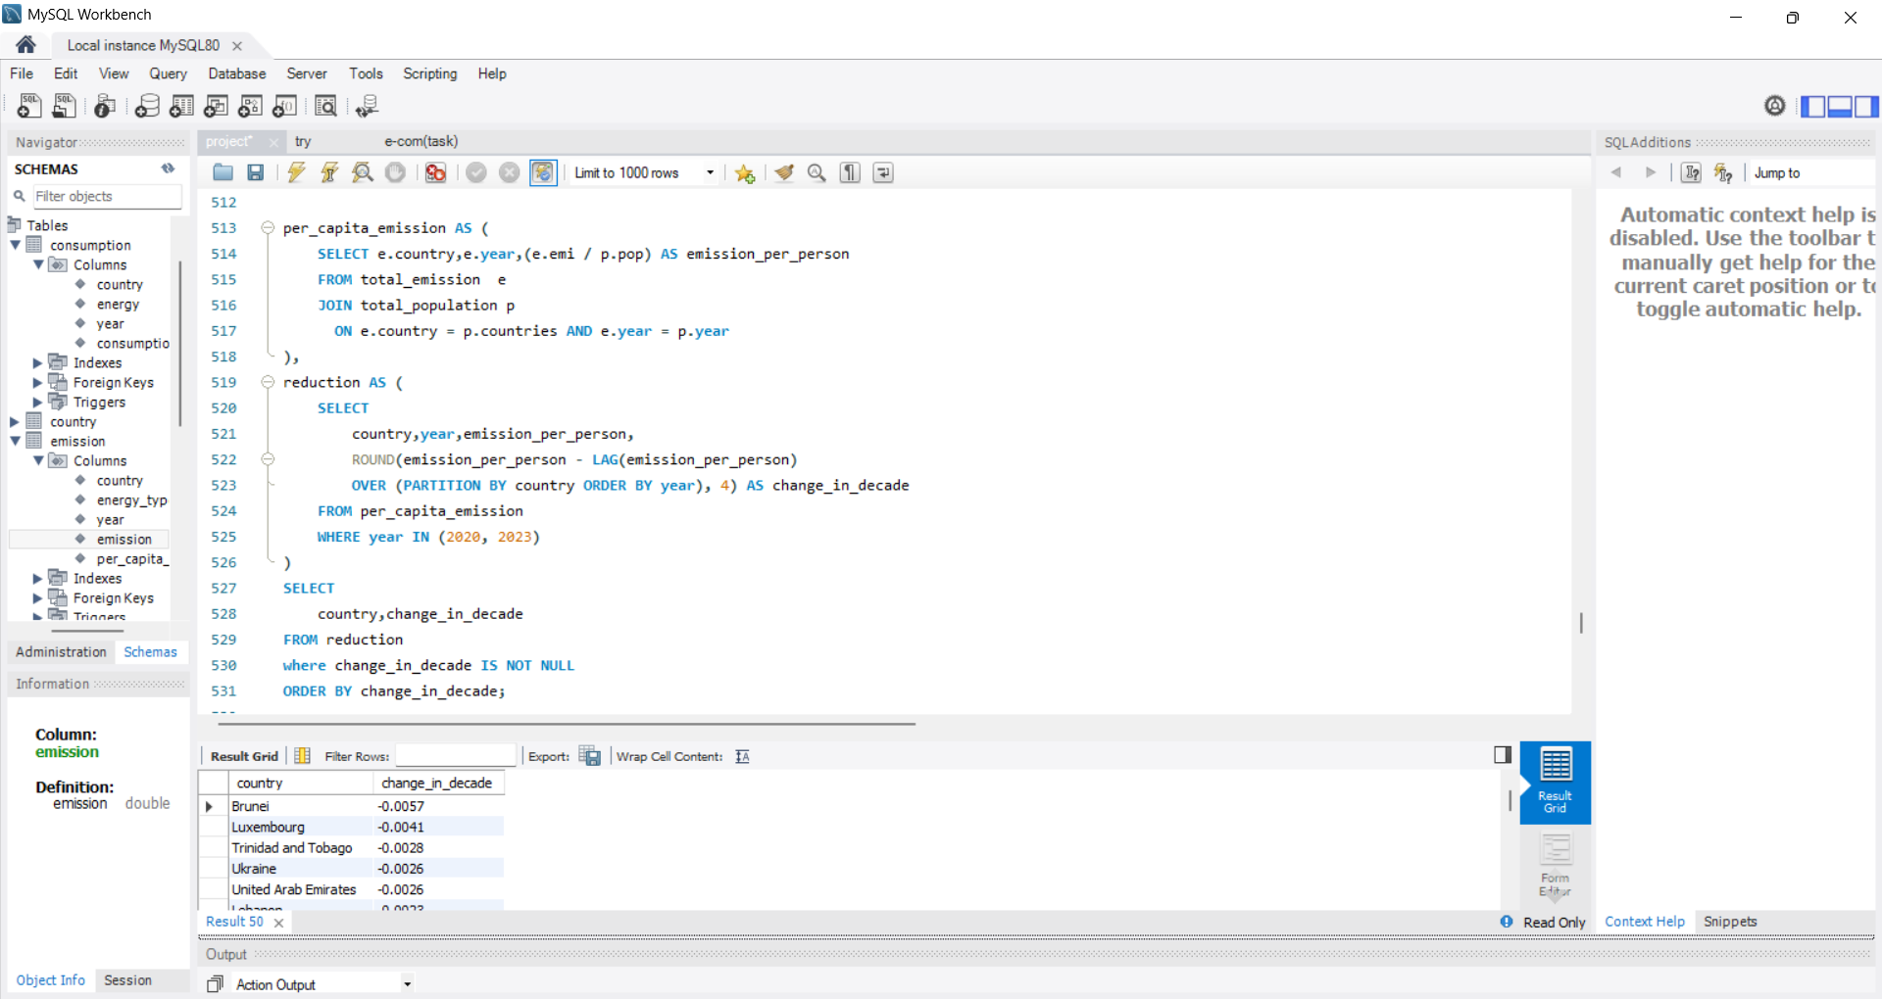


3. Which countries have improved (reduced) their per capita emissions the most over the last decade?
Query :

Slide 20
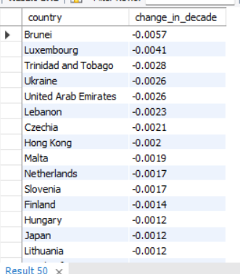
3. Which countries have improved (reduced) their per capita emissions the most over the last decade?
Output :
Insight:
Between 2020 and 2023, countries that lowered their per-capita emissions have shown strong progress in moving towards cleaner energy and better efficiency, setting an example for sustainable development.

Slide 21
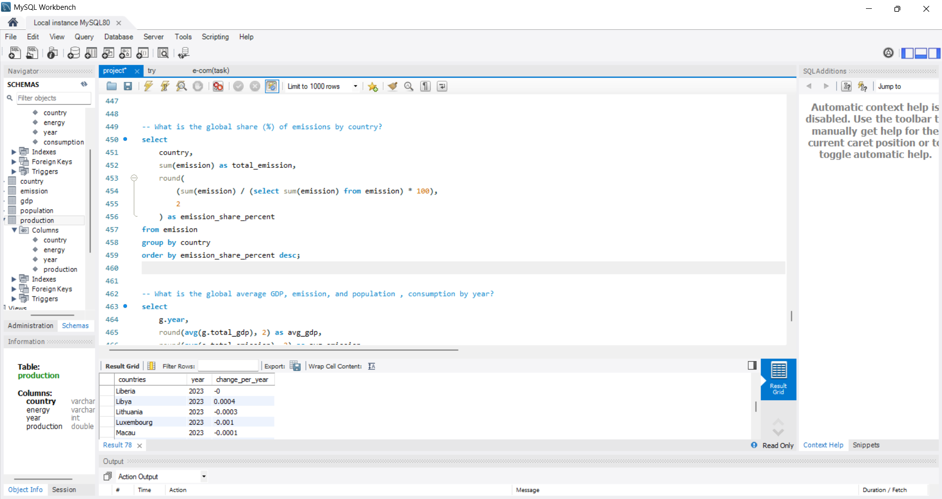


4. What is the global share (%) of emissions by country?
Query :

Slide 22
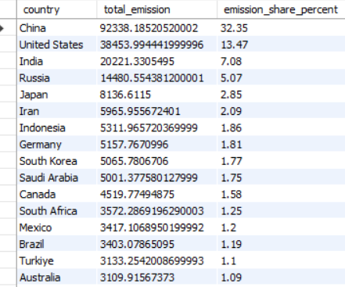
4. What is the global share (%) of emissions by country?
Output :
Insight:
The global share of emissions is heavily concentrated in a few major economies:
China contributes the largest share, accounting for around 32% of global emissions.
The United States is the second largest, with about 13%.
India follows with nearly 7%, reflecting its rapid industrial growth and rising energy demand.
Russia accounts for around 5%.
Together, these four countries make up over half of the world’s total emissions, which highlights a major global challenge.
The concentration of emissions in a few countries means that global climate targets cannot be achieved without significant action from these major emitters

Slide 23
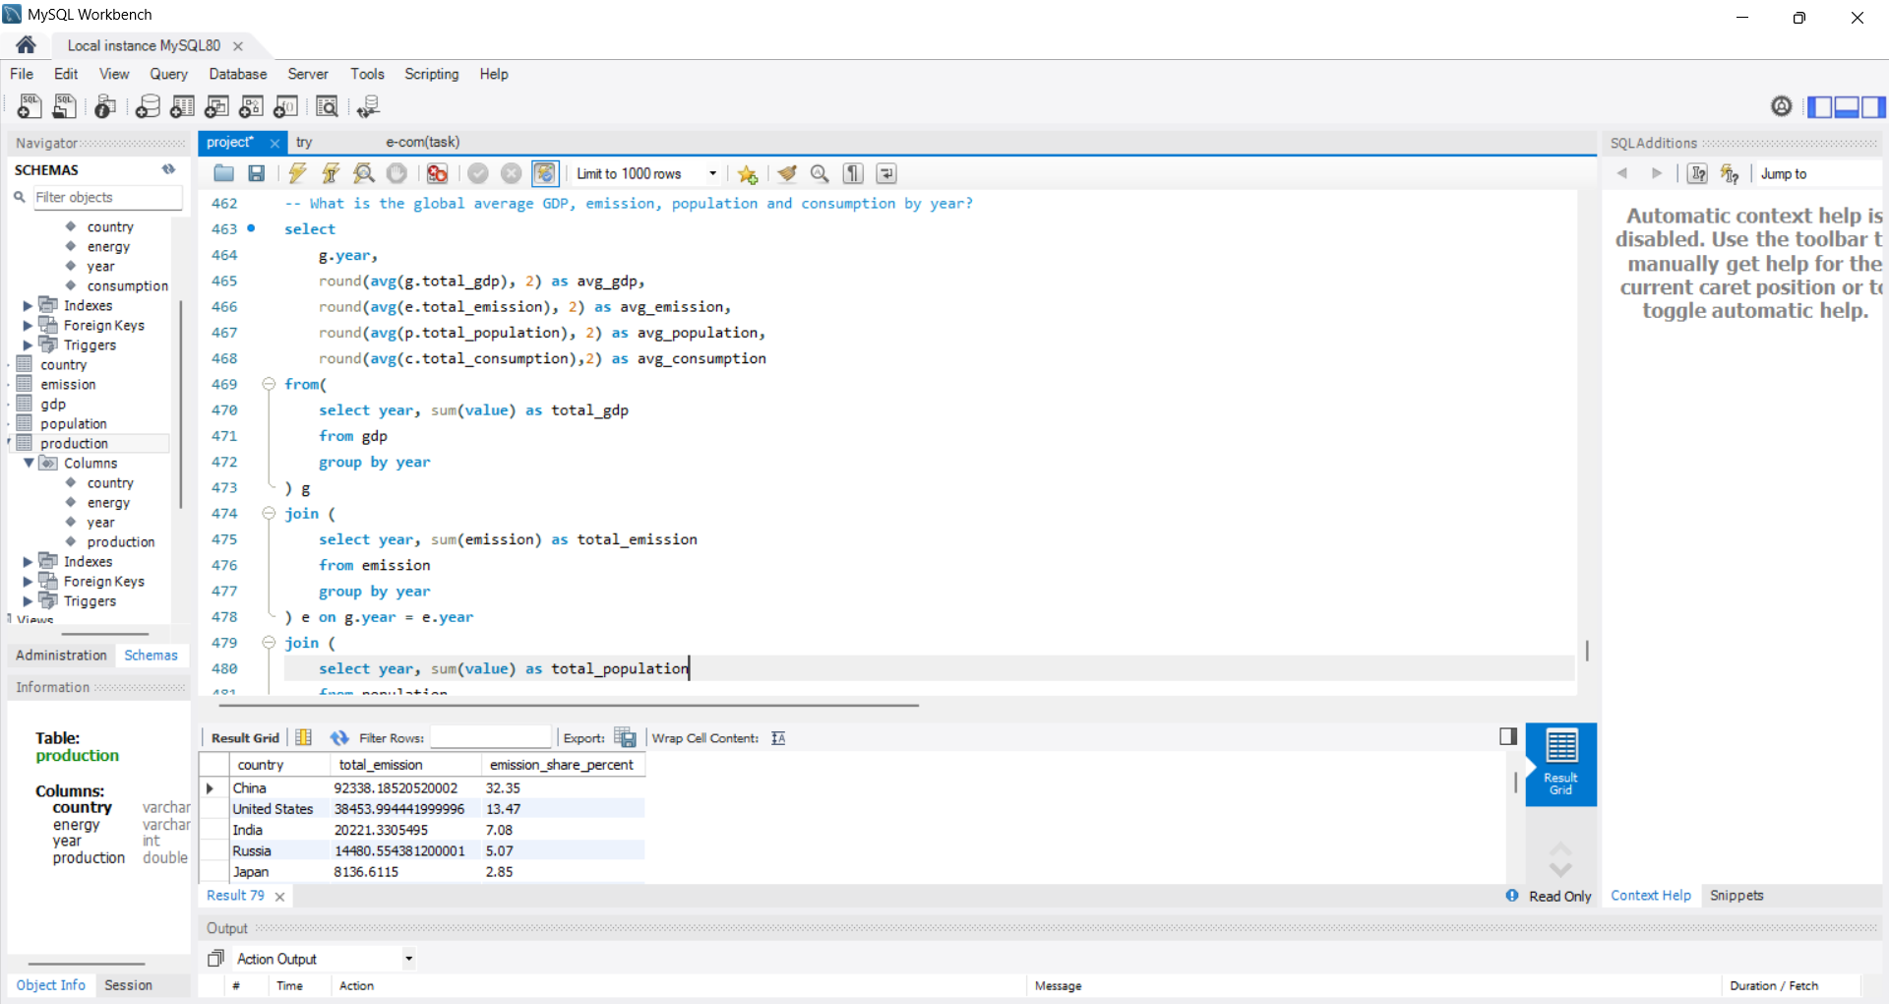
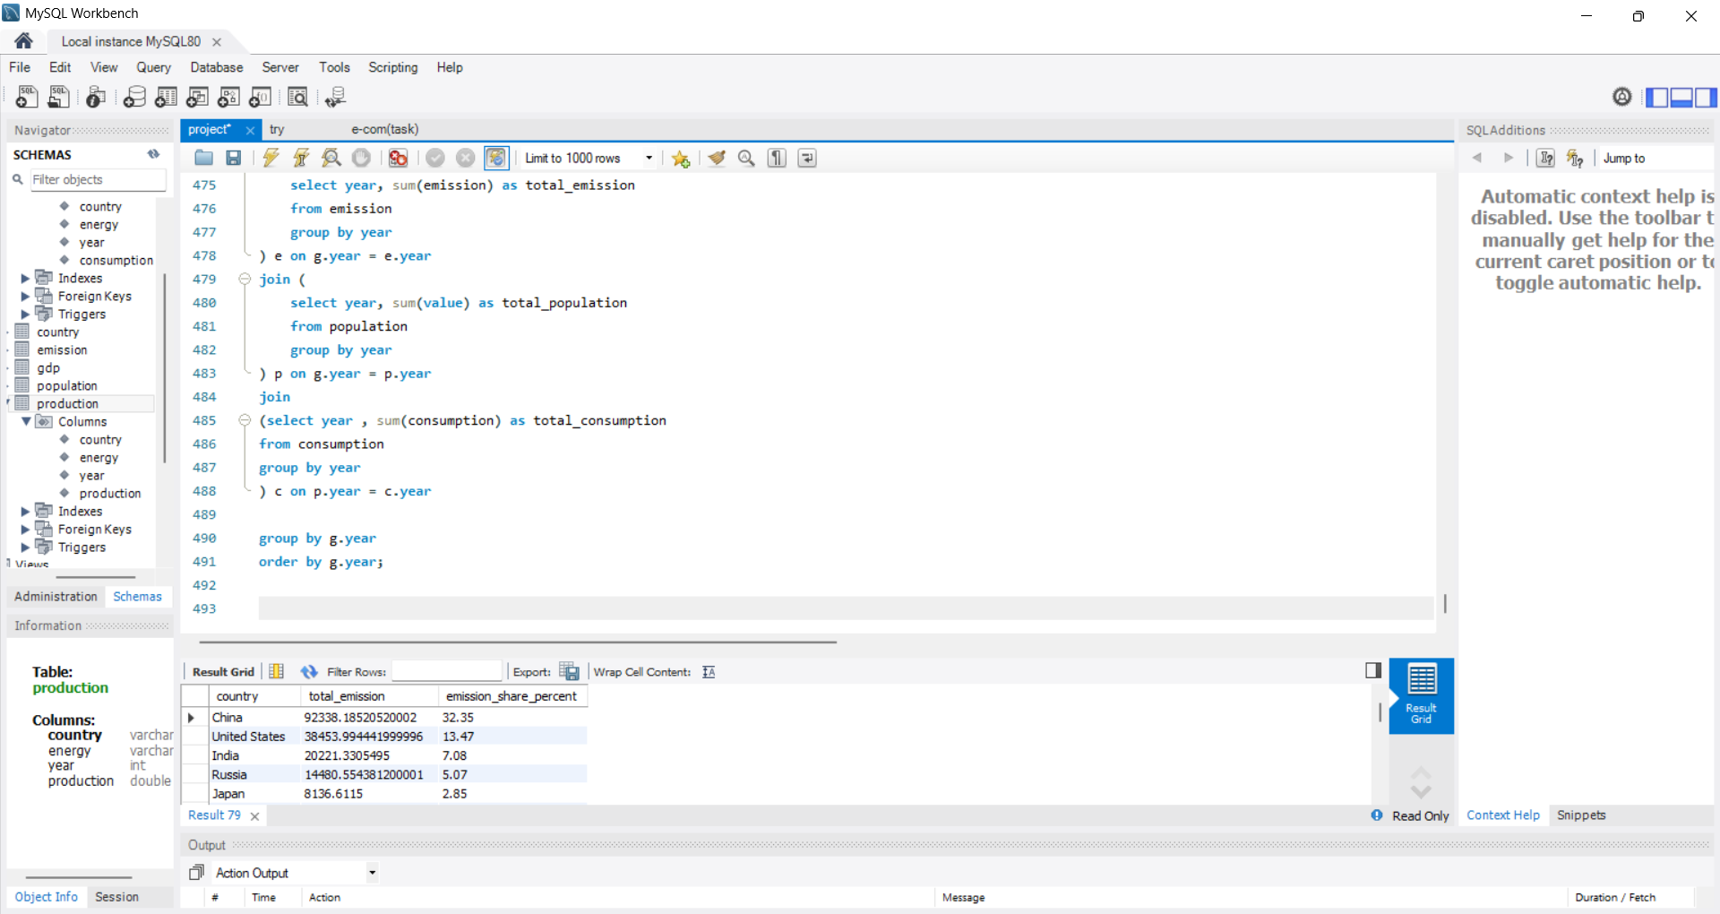
5. What is the global average GDP, emission, population and consumption by year?
Query :

Slide 24
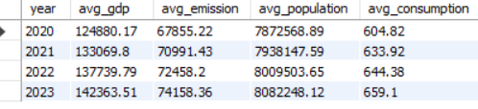
5. What is the global average GDP, emission, population and consumption by year?
Output :
Insight:
The world’s GDP and population are rising steadily, emissions remain high, and energy consumption is growing,
making it difficult to meet global climate goals.
Instead of a big reduction, emissions actually increased slightly.
This means economic growth is happening, but not in a “clean” way fast enough.
GDP is growing much faster than emissions are being controlled.
More people → more energy needed

Slide 25
Conclusion
Key Findings on Energy, Emissions & Economy
Emissions Concentration
A few countries (China, US, India, Russia) dominate global emissions, holding the largest emission shares.
GDP vs Emissions
Global GDP has risen faster than emissions reduction, meaning economies are growing but without enough decoupling from carbon intensity.
Energy Production & Consumption Imbalance
Several countries produce more energy than they consume (net exporters), while others rely heavily on imports (net consumers).
Between 2020–2023, consumption rose ~9% globally, showing rising energy demand despite climate concerns.
Population Growth Effect
Population growth directly amplifies emissions in developing countries, where energy demand per capita is still rising.
Developed countries show slower population growth but higher per capita emissions.
Global Averages (per year)
On average, GDP, emissions, population, and energy consumption have all increased over the last decade.
The world is growing wealthier and more energy-hungry, but not yet significantly cleaner.

Slide 26
Experience
My Experience & Challenges in the SQL Data Analysis Project
I learned how to use subqueries and CTEs (Common Table Expressions) to simplify complex queries and make the analysis more structured.
I discovered how to handle duplicate records effectively to ensure accuracy in results.
I gained experience in joining multiple tables (population, energy, GDP, emissions, etc.) to extract meaningful insights.
A key challenge was writing queries with multiple conditions and ensuring correct grouping/ordering for analysis.
I learned how to calculate year-over-year changes, per-capita values, and global averages using SQL aggregate functions and window functions.
Another challenge was understanding data relationships (e.g., linking energy consumption, production, and emissions with population/GDP).
By the end, I improved my ability to transform raw data into insights and strengthened my confidence in using SQL for real-world analytical tasks.

Slide 27
Any Questions

